Slide 1
Design Thinking Session
Brainstorming Exercises

Slide 2
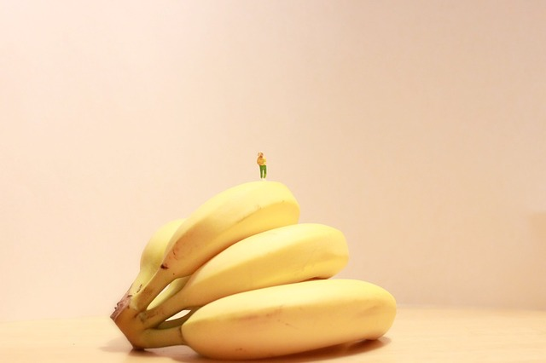
Brainstorming Exercise
What is the best way to
package bananas?
Notes:
In small groups of 3-4, brainstorm as many ways to package bananas. Encourage participants to think about form, function, materials, adhesives, etc. These work best when people apply the rule of Post-Its (write it, say it, stick it) and write/draw out the ideas.
At the end, ask if anyone thought about the banana peel? Banana peels are biodegradable, doesn’t require extra material and protect the part of the banana people actually eat.
We encourage participants to go wild with this exercise. In the past, Banana Uber and drones were considered acceptable!

Slide 3
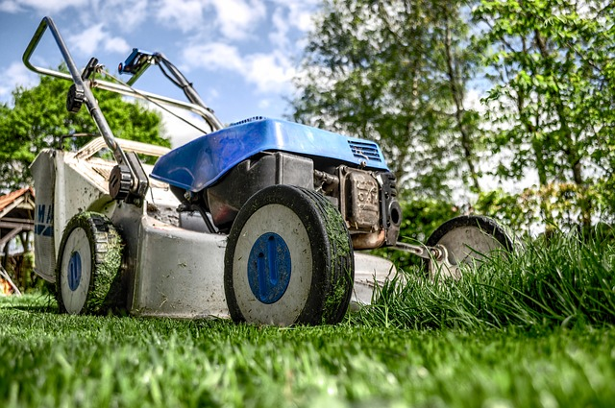
Brainstorming Exercise
How can we design a
better lawn?
Notes:
In small groups of 3-4, brainstorm as many ways to design a better lawn. Taking care of a lawn is hard work- it requires lots of water to keep it green, power to operate the lawn mower, fertilizer to keep weeds out, time/commitment/energy from people. What are ways to design a better lawn to mitigate some of these challenges?
Encourage participants to think about form, function, materials, processes, etc. These work best when people apply the rule of Post-Its (write it, say it, stick it) and write/draw out the ideas.
At the end, ask if anyone thought about getting rid of the lawn? Digging it out and pouring sand over it is one way to eliminate the challenges. Rethink the purpose of the lawn and why we need them.
We encourage participants to go wild with this exercise. In the past, Roomba for lawns and sensors were considered acceptable!

Slide 4
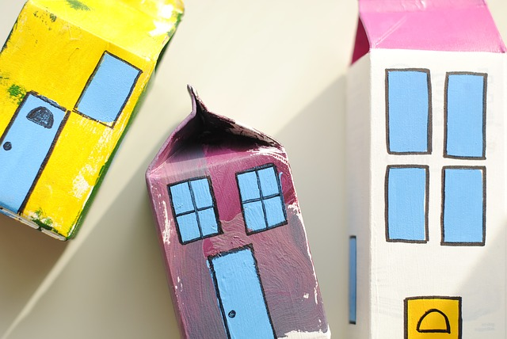
Brainstorming Exercise
When you were a child, what did you want to be when you grow up?
Follow this format: “I wanted to be a ________ when I grew up. Now, I’m a _____ and they both ________.”
Notes:
Individuals will write/draw what they wanted to be when they grow up following the format above.
For example: I wanted to be a doctor when I grow up. Now, I’m a data analyst and they both help patients.
At the end, encourage participants to stand up and share the drawing/writing.

Slide 5
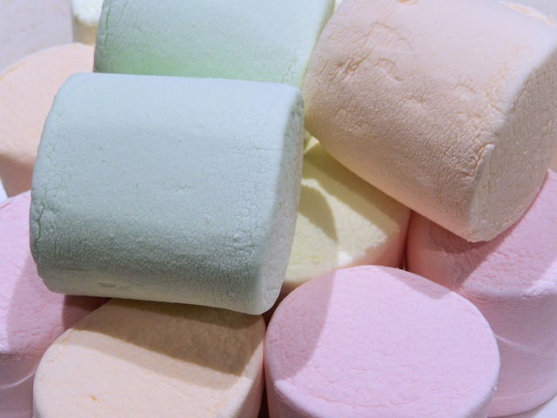
Team Building Exercise
Marshmallow Challenge
In 10 minutes, build the tallest free-standing structure out of 20 sticks of spaghetti, 3 feet of tape, 3 feet of string, and one marshmallow. The marshmallow must be on top.
Notes:
In 10-18 minutes, build the tallest free-standing structure out of 20 sticks of spaghetti, 3 feet of tape, 3 feet of string, and one marshmallow. The marshmallow must be on top.

Slide 6
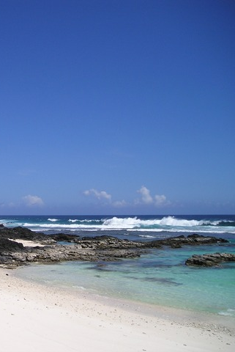
Mountains vs. Beaches
Notes:
Pair-up; one person will advocate for the mountains, the other will advocate for the beaches.
Go back and forth and come up with as many reasons why one is better than the other.
Ex:
Mountains are better because you can eat lots of trail mix while hiking.
Beaches are better because you can swim turtles and sharks.
Mountains are better because you can meet bears along the way.
Beaches are better because you can get a nice sun burn.
We encourage participants to go wild with this exercise.
More ideas: (Lions vs. Bears, City vs. Country, Staples vs. Tape, Apples vs. Oranges, etc)

