Slide 1


Orthopaedic Physical Therapy Clinical Residency
Program Overview

Slide 2
Clinical Residency
Residency Program Mission Statement:
To provide a post-professional clinical education experience that will facilitate and accelerate the attainment of advanced knowledge and skills in orthopaedic physical therapy. We seek to foster a growing body of skilled physical therapy providers that will elevate our entire clinical enterprise and the quality of rehabilitative services we provide to the community. We seek to foster a growing body of skilled physical therapy providers that will elevate our entire clinical enterprise

Slide 3
Clinical Residency
Residency Program Goals:
1. Support the mission of Carolinas HealthCare System by providing an organized educational opportunity that facilitates and accelerates excellence in orthopaedic physical therapy
2. Provide a curriculum consistent with the Description of Specialty Practice (DSP) in orthopaedic physical therapy practice so that residents will be prepared to achieve specialty certification in orthopaedic physical therapy
3. Offer a program that prepares physical therapists to contribute to the body of knowledge in orthopaedic physical therapy by participating in a clinical research project

Slide 4
Clinical Residency
Residency Program Goals:
4. Offer a program that prepares physical therapists to better serve their organization and community as advanced direct access providers, clinical leaders, and consultants/mentors for other clinicians
Offer a program designed to improve proficiency in the application of manual examination and treatment procedures, functional movement assessment, and therapeutic exercise prescription
Offer a program that ensures each resident has a consistent experience across all practice sites
7. To be a nationally recognized provider for post-professional clinical training within selected areas of physical therapy specialty practice

Slide 5
Clinical Residency
Resident Objectives:
1. The resident will practice advanced orthopaedic physical therapy clinical skills
2. The resident will demonstrate the skills necessary to critically review the scientific literature pertinent to orthopaedic physical therapy
3. The resident will participate in a clinical research project
The resident will be prepared to be an autonomous provider of physical therapy services within their specialized area of clinical practice
The resident will acquire the tools necessary to develop professionally as a mentor, a teacher, and a resource for other physical therapists and members of the healthcare community
6. The resident will pursue ABPTS certification within their practice specialty upon program completion

Slide 6
Faculty Background
7 board-certified in orthopaedic physical therapy (OCS)
North American Institute of Orthopaedic Manual
Therapy (NAIOMT)/Clinical Fellowship Instructor/Fellow,
AAOMPT
University of St. Augustine manual therapy certification
(MTC)
American Academy of Manipulative Therapy (AAMT)
/Fellow, AAOMPT
Andrews University DScPT program
Functional Movement SystemsTM (FMS & SFMA)
SportsmetricsTM certification (Cincinnati SportsMedicine)
Myopain Seminars (Trigger Point Dry Needling)
Institute of Physical Art
Graston Technique® (IASTM)

Slide 7
Residency Faculty
Mike Agnone, PT, OCS, CMTPT, ATC
David Aiken, PT, DSc, OCS, COMT, CMTPT, ATC, FAAOMPT (Residency Program Director)
Susan Aiken, PT, OCS
Marco Caiazza, PT, MTC, MHA
William Freres, PT, CMTPT, Cert. DN, Cert. SMT, FAAOMPT
Stephanie Levi, PT, DPT, OCS, CMTPT
Matt Minard, PT, DPT, OCS, CMTPT, Cert. MDT
Gary Of, PT, DPT, OCS, CMTPT

Slide 8
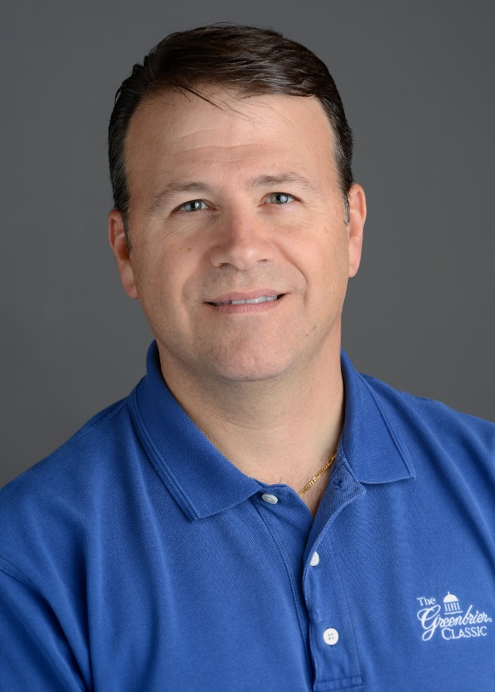
Residency Faculty
Mike Agnone
  BSPT, SUNY Buffalo
  MS, Athletic Training, Indiana State University
  Certified Athletic Trainer (ATC)
  OCS – 2007/2016
  Certified Manual Trigger Point Therapist (CMTPT) – Myopain Seminars
  Center Manager – CR Randolph, CR Mt Island Lake, and CR Harris YMCA

Slide 9
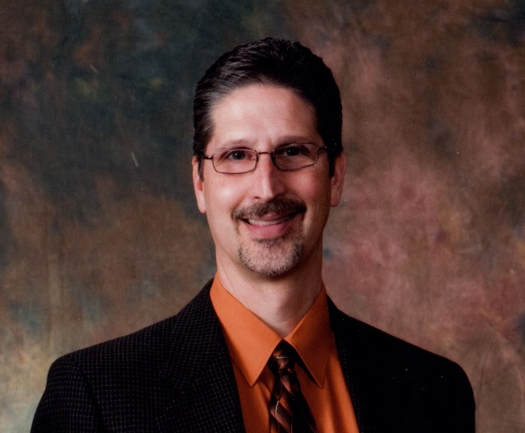
Residency Faculty
David Aiken
  MPT, Emory University
  DScPT, Andrews University
  OCS – 1993/2003/2013
  Certified Athletic Trainer (ATC)
  NAIOMT Manual Therapy Fellowship program (FAAOMPT)
  COMT & Clinical Fellowship Instructor (CFI), NAIOMT
  Certified Manual Trigger Point Therapist (CMTPT) –
  Myopain Seminars
  Outstanding Physical Therapist award, NCPTA
  Center Manager – CR Ballantyne, CR Union West, and CR Sara’s YMCA

Slide 10
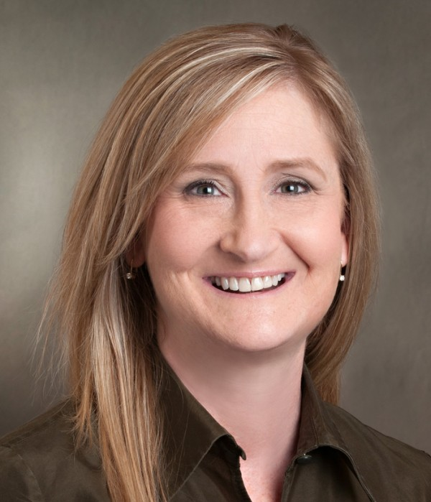
Residency Faculty
Susan Aiken
  MPT, Emory University
  OCS – 1996/2006/2014
  PT Manager – OrthoCarolina, Matthews
  Specializes in upper extremity rehabilitation

Slide 11
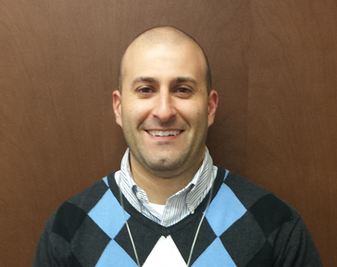
Residency Faculty
Marco Caiazza
  BSPT, Daemen College
  MHA, Pfeiffer University
  Center Manager – CR Pineville
  Certified Manual Therapist (MTC), University of Saint Augustine
  Credentialed Clinical Instructor,
  APTA
  Mabel award (UNC Chapel Hill) for excellence in clinical education

Slide 12
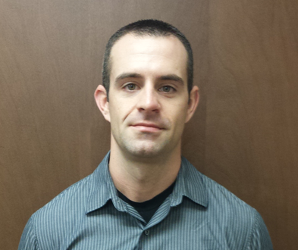
Residency Faculty
Will Freres
  MPT, Northern Illinois University
  CR Orthopaedic PT Residency graduate – 2012
  Certified Manual Trigger Point Therapist (CMTPT) – Myopain Seminars
  AAMT Manual Therapy Fellowship program (FAAOMPT)
  Cert. DN, Cert. SMT – AAMT
  Level III Staff PT – CR Ballantyne

Slide 13
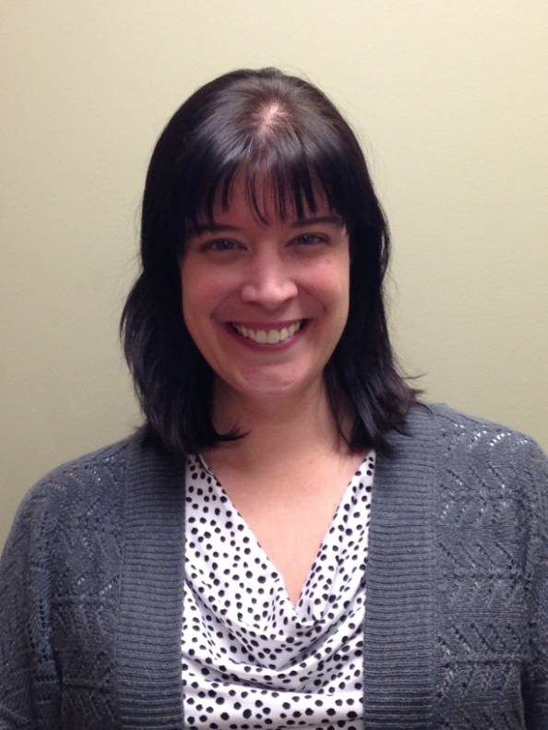
Residency Faculty
Stephanie Levi
  DPT, Washington University (St. Louis)
  OCS – 2014
  Certified Manual Trigger Point Therapist (CMTPT) – Myopain Seminars
  Credentialed Clinical Instructor, APTA
  Certified Tai Chi Instructor for Arthritis
  Level III Staff PT – CR Ballantyne

Slide 14
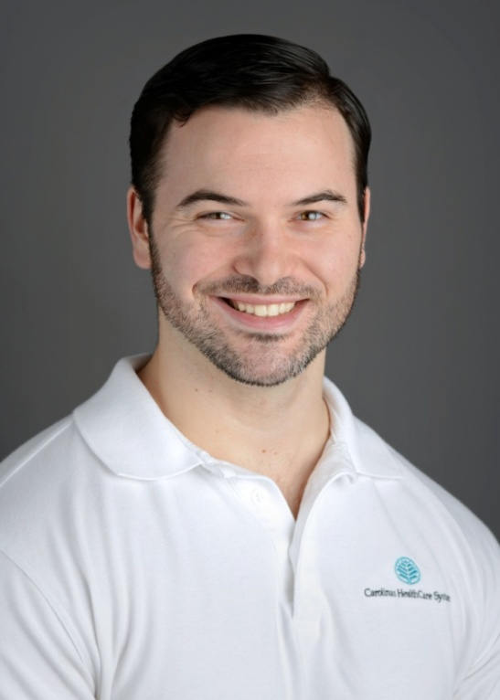
Residency Faculty
Matt Minard
  DPT, University of Dayton
  CR Orthopaedic PT Residency graduate – 2014
  OCS – 2015
  Certified Manual Trigger Point Therapist (CMTPT) – Myopain Seminars
  Cert. MDT – McKenzie Institute
  Certified Strength & Conditioning Specialist (CSCS)
  Level III Staff PT – CR Harris YMCA

Slide 15
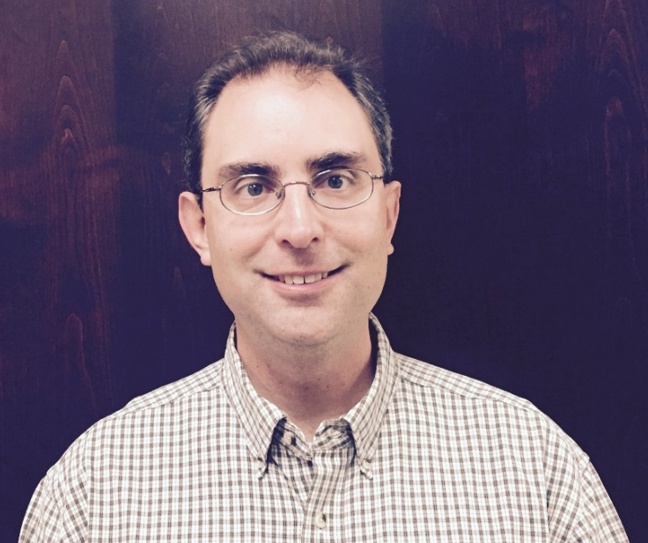
Residency Faculty
Gary C. Of
  BSPT, SUNY Stony Brook
  DPT, SUNY Stony Brook
  OCS – 2012
  Level III Staff PT – CR Charlotte
  Certified Manual Trigger Point Therapist (CMTPT) – Myopain Seminars
  Specializes in Functional Manual Therapy (IPA) approach

Slide 16
Program Philosophy
The human body is an interconnected dynamic system with
its function dependent on the interrelationship of the
myofascial, articular, and neuromuscular systems
Pain related to the musculoskeletal system is most
effectively managed when treatment is directed towards
optimizing efficient functional movement
The primary role of the orthopaedic physical therapist is to
identify impairments to efficient functional movement
involving the articular, myofascial, and neuromuscular
control systems and, through treatment and education,
resolve these impairments
Integrating current best evidence with an eclectic philosophy
and the ICF as the model for a patient centered care
approach

Slide 17
Residency Program Overview
12 month duration (49 weeks) – January to December
36 hours/week patient care (1728 hrs)
152 hours of 1:1 mentoring with faculty during patient
care (4 hrs/wk x 38 weeks)
Mentoring with: board-certified orthopaedic PTs (OCS),
TMJ specialist, certified manual/manipulative
PTs/AAOMPT fellows, hand therapy specialists, certified
myofascial trigger point therapists (CMTPT)
4 hours/week of faculty instruction – didactic/lab (168 hrs)
Myopain Seminars trigger point dry needling (DN1)
(optional instruction)
Interaction with NPs/PAs through Center for Advanced Practice
Physician shadowing with an orthopedist, internal/
family medicine physician w/sports medicine specialty
(or physiatrist), and radiologist (34 hrs)
Independent readings, projects, and assignments

Slide 18
Curriculum Components
1. Evidence-Based Physical Therapy 2. Clinical Reasoning 3. Foundations of Orthopaedic Physical Therapy | January
4 Medical Management of the Orthopaedic & Musculoskeletal Patient 5. Principles of Differential Diagnosis & Medical Screening | February
6. Functional Orthopaedic Rehabilitation | March
Lumbar Spine/Pelvic Girdle/Hip – Regional Examination, Evaluation, and Management | April - May
Thoracic Spine/Cervical Spine/Shoulder Girdle – Regional Examination, Evaluation, and Management | June - August
Knee/Ankle-Foot/TMJ/Elbow/Wrist-Hand – Regional Examination, Evaluation, and Management | September - November

Slide 19
Evidence Based Physical Therapy
Basic Statistics for Understanding the PT Literature
Residency Project
Clinical Reasoning
Foundations of Orthopaedic Physical Therapy
Tissue Injury & Healing
Principles of OMPT
Differential Diagnosis & Medical Screening
MD Shadowing
Diagnostic Imaging
Principles of Diff Dx & Medical Screening
Upper & Lower Quadrant Scan Exams
Pharmacology
Functional Orthopaedic Rehabilitation
Movement Assessment/SFMA
Functional Rehabilitation of the Spine
Soft Tissue Mobilization
Segmental Stabilization
Orthopaedic PT Examination & Treatment
L-Spine/Pelvis-SIJ/Hip T-Spine/C-Spine/Shoulder Girdle
Knee/Ankle-Foot TMJ; Elbow/Wrist-Hand
Aging Spine & NS Compromise
Current Concepts in Pain
Medical Management of the Orthopaedic/MSK Patient
Intro to Articular Biomechanics
Clinical Reasoning
Communication Skills
Post-Op Rehab

Slide 20
Typical Resident Weekly Schedule
 | SUNDAY | MONDAY | TUESDAY | WEDNESDAY | THURSDAY | FRIDAY | SATURDAY
7:30 AM
8:00 AM |  | Patient care | Lecture/Lab | Mentoring | Patient care | Patient care
9:00 AM
10:00 AM
11:00 AM
12 NOON |  | LUNCH | LUNCH | LUNCH | LUNCH | LUNCH
1:00 PM |  | Patient care | Patient care | Patient care | Patient care | Patient care
2:00 PM
3:00 PM
4:00 PM
5:00 PM
6:00 PM

Slide 21
Curriculum Resources
Orthopaedic Section Monograph Series & Resources:
Current Concepts of Orthopaedic Physical Therapy, 4th ed.
Diagnostic Imaging in Physical Therapy
Pharmacology
Postoperative Management of Orthopaedic Surgeries
Basic Statistics for Understanding the Physical Therapy
Literature
Required Texts:
Cook/Hegedus, Orthopedic Physical Examination Tests:
An Evidence-Based Approach, 2nd ed.
McEwen, Writing Case Reports: A How-to-Manual for
Clinicians, 3rd ed.

Slide 22
Curriculum Resources
Recommended Texts:
Placzek/Boyce, Orthopaedic Physical Therapy Secrets,
2nd ed.
Cook, Movement: Screening, Assessment, and Corrective
Strategies
Sueki/Brechter, Orthopedic Rehabilitation Clinical Advisor
For Trigger Point Dry Needling Instruction:
Dommerholt/Fernandez-de-las-Penas, Trigger Point Dry
Needling: An Evidenced and Clinical-Based Approach
(required)
Kostopoulos/Rizopoulos, The Manual of Trigger Point and
Myofascial Therapy (recommended)

Slide 23
Curriculum Resources
DVD/Videos:
The Scan Exam (NAIOMT)
Exercises for the Lumbar Patient (IPA)
Key Functional Exercises You Should Know (Cook)
Examination and treatment techniques
Current Research:
Research articles relevant to topics of instruction
Required and optional readings
Article selections will vary with new research developments

Slide 24
Resident Evaluation
Weekly Feedback Forms:
Clinical Supervision form
Clinical Instructor Prep form
Clinical Skills Performance:
APTA Self-Assessment Tool
ABPTS Assessment Tools for PTs – Orthopaedic
Performance of Examination & Treatment Procedures:
1 Practical Examination (Functional Orthopaedic Rehab skills)
2 Oral-Practical Examinations (1 spine, 1 extremity)
2 Live Patient Examinations (1 spine, 1 extremity)

Slide 25
Resident Evaluation
Written Examinations:
Foundations of Orthopaedic Physical Therapy
Principles of Differential Diagnosis & Medical Screening
Orthopaedic Section monograph examinations
Basic Statistics for Understanding the Physical Therapy
Literature
Assignments and Projects:
Professional Portfolio
Clinical Reasoning assignments
Physician Observation Reflective paper
Final Residency Project (case study) and Presentation

Slide 26
Resident Feedback
"Since completing the residency program, my ability to treat the orthopaedic patient has skyrocketed. As patient outcomes have improved, so too, has my confidence. Receiving one-on-one mentorship from an eclectic faculty who help blend the art and evidence of physical therapy is invaluable. It is a level of clinical development not possible through school or continuing education courses alone.”
– Dr. Matthew C. Johnson, PT, DPT, OCS
"I'm a unique resident in that I entered the program with 17 years of experience. I was pleased and surprised that the sections that I performed best on the OCS exam were the areas of my clinical practice that I felt weakest prior to the residency program - a true testament to the quality of both the faculty and the curricula. I am now more skilled, more effective, and more efficient than I've ever been. My patients experience the difference, my colleagues respect the growth, and my superiors rely on the excellence."
– Dr. Andrew M. Ball, PT, DPT, PhD, MBA, OCS, CMTPT

Slide 27
Resident Feedback
"Carolinas Rehabilitation's orthopaedic residency program and their elite orthopaedic providers helped propel my clinical skills at least 10 years into the future. The bond that I formed with all those involved with this program will last a lifetime...so will the learning."
– Will Freres, PT, MPT, CMTPT, Cert. DN, Cert. SMT, FAAOMPT
“The orthopaedic clinical residency program at Carolina Rehabilitation is not only the reason I moved to Charlotte, NC from Ohio, but also the reason that I will stay. The program met and exceeded all of my expectations. Being a new graduate, it was the perfect transition to link the didactic material we learned in school, to the ‘real world’ clinical skills in the exciting and challenging world of orthopaedic physical therapy. The program sets you up with a foundation that will facilitate a career worth of learning and self-development. It is perfect for individuals who have a strong passion for the field of physical therapy and truly enjoy helping people. Following the residency, I not only have more confidence, I have more enhanced outcomes and am able to more effectively treat a larger population of patients with an eclectic approach. Not to mention, I made lifelong friends and connections along the way.”
– Dr. Matthew T. Minard, PT, DPT, OCS, CMTPT

Slide 28
Resident Feedback
“In the pursuit of clinical mastery, there are several vehicles that allow a beginner to cross the chasm through mindful practice. One of the biggest reasons to choose to pursue residency training at Carolinas Rehabilitation is the combined wisdom and teachings of the faculty that allow the resident to grasp and handle the true meaning and spirit of “best practice”. This relationship not only benefits the clinician, but patients as well.”
– Jennifer Bent, PT, MPT, OCS, CMTPT, Fellow-in-Training
“I can say that completing Carolinas Rehabilitation’s orthopedic residency program was the best decision of my young career. I am comfortable and confident treating any orthopedic patient that I may see in the future and have a great foundation for success. Being surrounded by a group of elite clinicians has propelled both my skill set and clinical reasoning to a level that would have taken years to achieve. This residency program was above and beyond my expectations and I would recommend it to anyone with a passion for excellence.”
– Dr. Matt Crandall, PT, DPT, OCS, CMTPT

Slide 29
Resident Feedback
“I was a new graduate when I entered the program and I felt like I needed some sort of direction or structure to become a better therapist. I was fortunate to have a group of mentors that I could learn from, all with different backgrounds and it really helped. I learned a lot of assessment and treatment techniques, honed my psychomotor skills, and forged decent clinical reasoning processes. I met all the goals I had for myself and then some and this is truly the best money I ever spent. This residency was amazing and I recommend it highly to anybody.”
– Dr. Michael Masi, PT, DPT, OCS, CMTPT, CSCS, CISSN
“This residency program has been life changing. I entered the program with about 5 years of experience. I was able to gain more experience in one year than I did in my first five years of practice. Every week was like taking part in a new continuing education class. A real top of the line program with top-notch faculty members who are truly invested in your clinical growth.”
– Dr. Zachary Johnson, PT, DPT

Slide 30
Resident Feedback
“I learned so much from each and every faculty member. It was obvious that each is very invested in the success of each resident that comes through this program. I am so glad I went through the residency last year. Best career move ever.”
– Dr. Kelli Tryon, PT, DPT, OCS
“Participating in the orthopaedic physical therapy clinical residency at Carolinas Rehabilitation was the best possible decision I could’ve made to start my career. Throughout this year, my ability to efficiently and effectively examine, evaluate, and treat patients has improved dramatically. The didactic experiences, clinical mentorship, and instruction in trigger point dry needling have all been instrumental to my development as a clinician. It was great to be able to learn from such an eclectic group of faculty members who are passionate about developing the next generation of expert clinicians.”
– Dr. Ryan G. Wilkins, PT, DPT, CSCS

Slide 31
Resident Feedback
“The Carolinas Rehabilitation Orthopaedic Physical Therapy Residency program provided the opportunities to enhance my knowledge and clinical skills. Most importantly, the residency provided mentorship and direction from many highly skilled, experienced therapists that enhanced my clinical reasoning. I truly feel that by completing this program that I gained a head start to my career and created a great foundation to build from going forward.” – Dr. Matthew Skorheim, PT, DPT

Slide 32
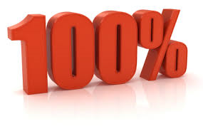
Resident
OCS Exam
Pass Rate 2011-2016

