Slide 1
Carolinas HealthCare System
Organizational Structure & Priorities

Slide 2
Gene Woods, CEO Introduces
New Mission & Vision Statements

Slide 3


Slide 4
Carolinas HealthCare System
A national leader in the transformation of healthcare services, provides a full spectrum of healthcare and wellness programs throughout North and South Carolina. Its diverse network of facilities includes academic medical centers, hospitals, freestanding emergency departments, physician practices, behavioral health centers, surgical and rehabilitation centers, home health agencies and nursing homes, as well as hospice and palliative care services
The system now counts:
  900 –plus care locations
  40 acute care and specialty hospitals
  7,800 licensed beds
  Employs nearly 60,000 people (full-time and part-time) including more than 3,000 system physicians and advanced clinical practitioners
  Total Annual net revenue for properties owned or managed by CHS is now over $8 billion

Slide 5
MISSION
To improve health, elevate hope, and advance healing – for all
VISION
To be the first and best choice for care

Slide 6
Core Values
Caring: We treat our customers with dignity, giving them the courtesy and gentleness they need. We are helpful; we listen; we communicate; we respond to patient needs
Commitment: We are dedicated to Carolinas HealthCare System, taking pride in our organization and our jobs, projecting a professional image and striving to be the best in all we do
Integrity: We honor and uphold confidentiality, are honest and ethical, keep our commitments, accept responsibility for our actions and respect the rights of patients, families and each other
Teamwork: Linked by our common mission, Carolinas HealthCare System respects the professionalism and contributions of our coworkers, understands that physicians are an integral part of the team, values diversity in all its forms and recognizes that people are our greatest assets

Slide 7
Diversity & Inclusion

Slide 8
System-wide Diversity Strategy and Infrastructure

Slide 9

Our Beliefs about Diversity
Critical Thinking, Innovation & Transformation
Epidemiological Variations
Shifting Demographic Trends
Median Age of Populations
Compliance & Legal Liability
Notes:
Representation at all levels of the organization remains a key, critical pillar and linkage for critical thinking, innovation and transferable knowledge to ensure leadership in the transformation of healthcare delivery.
Health disparities do exist. Disparities pertaining to healthcare access and health outcomes. Go to disparities slide.
The business of healthcare is evolving right before our eyes. The old adage of “what got you here, won’t get you there…” is very much applicable as many organizations are forcing delivery systems to adjust strategy to stay relevant with the changing labor and consumer market.
The average age of people of color is younger than majority population. Average white person in US is 43. Asian is 37. Black is 33. Latino is 28. This is relevant as many health systems attempt to assess what being a “provider of choice” for tomorrow’s patient will look like.
And lastly, diversity management and cultural competence are tools to address the transformation occurring throughout our industry.
Original Text:
• Diverse employee representation at all levels can help ensure that we have the knowledge, critical
thinking and innovation required of a leader in the transformation of healthcare delivery.
• Dramatic epidemiological variations exist across racial and ethnic groups in terms of vulnerability and health risks, incidence and prevalence rates of a variety of clinical conditions.
• Shifting demographic trends are forcing healthcare delivery systems to assess their marketing,
service and product delivery, and human resource strategies to remain competitive in the changing
labor and consumer markets.
• The median age of populations of color is more than 10 years younger than the majority population
and comprises a greater proportion of the young, healthy segment of our communities.
• Diversity management will prepare us to respond appropriately to the increasing demands of state
and federal efforts aimed at health care reform, thereby facilitating compliance and reducing legal
liability.

Slide 10
DIVERSITY & INCLUSION AGENDA
Workforce
Enhance the diversity and cultural competency skill-set of our teammates
Community
Enrich the health status of those who live
and work in the communities we serve.
Diverse Customers
Identify trends and develop segmentation strategies that target the fastest-growing populations of the region.
Culturally
Competent Care
Provide culturally and
linguistically competent care
to improve the health status of
our increasingly diverse patient population.
Internal External
The four pillars of the Diversity Agenda serve as the framework through which diversity
initiatives are developed and implemented throughout Carolinas HealthCare System.

Slide 11

CHS System Resource Groups (SRGs)
EQualityONE
(LGBTQ + Allies)
One Team One Mission
(Veteran & Military + Allies)
UNIDOS
(Latino(a)
/Hispanic + Allies)
Women’s Executive Leadership
(Female Leaders+ Allies)
Young Professionals
(YPs + Allies)
Men’s Diversity Leadership Network
(Men of Color + Allies)
Multicultural Physicians
(Physician + Allies)
Teammate – Driven Affinity Groups
Office of Diversity & Inclusion
Support Workforce Retention & Development
Community Engagement and Service
Support the
Diversity Agenda
Notes:
Original Text:
System Resource Groups (SRGs) are a critical part of Carolinas HealthCare System’s diversity infrastructure. These teammate-driven, affinity groups are accountable for leveraging their cultural expertise to support the Diversity Agenda, as well as, advance the mission and goals of the organization. SRGs support workforce retention, and professional development, while representing Carolinas HealthCare System in the communities we serve.

Slide 12
CHS Diversity Councils & Advisory Committees
Northern Division Diversity & Inclusion Council
Clinical Cultural Competence Council
Central Division Diversity & Inclusion Council
Physician Diversity Advisory Committee
Medical Group Diversity & Inclusion Committee
HR Innovation Diversity & Inclusion Committee
Southern Division Diversity & Inclusion Council
Provide Oversight
& Guidance on Diversity Initiatives
Assure Progress Toward Strategic Objectives
Office of Diversity & Inclusion
Leverage & Implement Best Practices
Support The
Diversity Agenda
12
Notes:
Original Text:
The Diversity Advisory Committees and Councils are a critical part of Carolinas HealthCare System’s diversity infrastructure. These groups provide guidance and oversight to leverage and implement diversity best practices across Carolinas HealthCare System. They partner with the Office of Diversity and Inclusion, as well as CHS leaders to assure progress toward achievement of aligned diversity objectives that support the Diversity Agenda, as well as, the mission and goals of the organization.

Slide 13

Medical Group Diversity and Inclusion Committee
Strategic Objectives
Physician Workforce
Physician & Administrative Leadership
Key Diversity and Inclusion Performance Indicators
Sustainable Measurement & Accountability
Strong Culture of Learning
Notes:
Original Text:
Purpose -
The Carolinas HealthCare System Medical Group Diversity and Inclusion Committee is charged with developing and enhancing structures and processes that facilitate a more inclusive environment for the physician workforce. Our organizational culture, systems, practices, values, behaviors, and processes will be a model for inclusion and considered a best practice.

Slide 14
Building an INCLUSIVE CULTURE..…. Inclusive Culture….

Slide 15
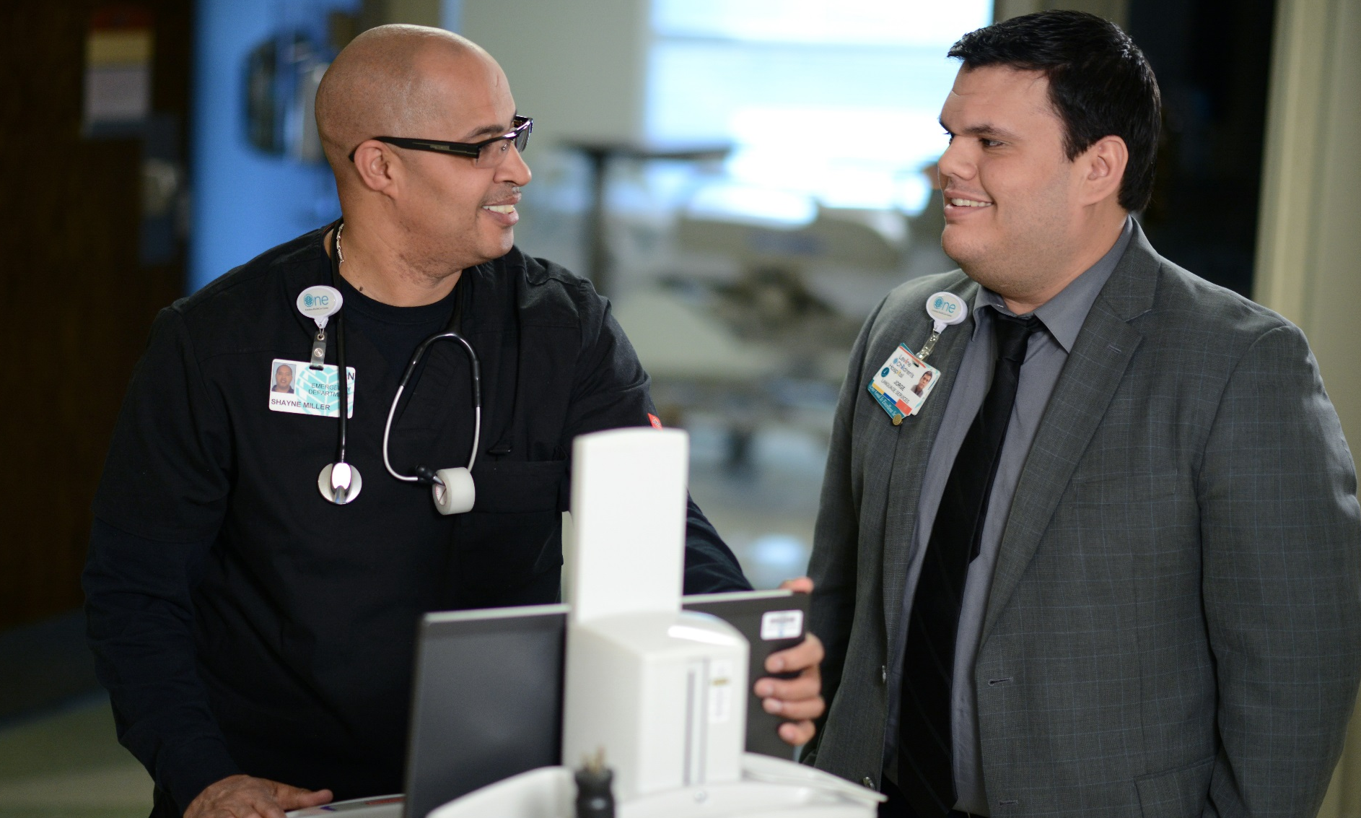
Culturally Competent Providers …
Assess Themselves
Express Themselves
Form Relationships
Seek Knowledge
Respond Effectively
Challenge Prejudice
Recognize Strategies
Notes:
Original Text:
Engage in self-assessment
Express individual heritage, values, beliefs, and biases
Form relationships based on trust and caring even in the
face of individual differences
Acquire knowledge about and are willing to listen to other perspectives
Develop effective responses to challenges posed by new or uncomfortable situations
Show openness and willingness to challenge prejudice and misperceptions
Recognize similar and different communication, motivational,
and decision-making strategies

Slide 16
Culturally Competent Care
– Clinical Encounter
Verbal Communication
Non-Verbal Messages
Cultural Values
Health Beliefs and Practices
Clinician
Patient

Slide 17

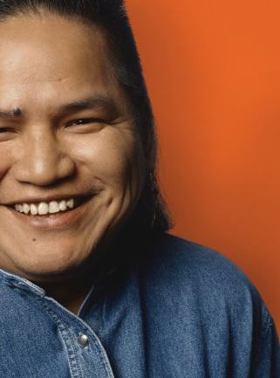

Culture Vision™
Comprehensive web-based database
On - the - spot access to culturally competent patient care!
38 ethnicities
13 religions
12 additional communities
PeopleConnect/Tools/Alpha Tools/CultureVision™
OR
PeopleConnect/Clinical/ClinicalOverview/CultureVision™
17

Slide 18

Unconscious Bias: Key Concepts
If You are Human……You are Biased
Bias serves as a fundamental protective mechanism for human beings
Unconscious bias comes from social stereotypes, attitudes, opinions, and stigma we form about certain groups of people outside our own conscious awareness
All of us hold unconscious beliefs about various social and identity groups, as defined by race, gender, age, sexual orientation, ethnicity, physical ability or disability
18
Notes:
· Bias Is defined as a strong inclination of the mind or a preconceived opinion about something or someone. A bias may be favorable or unfavorable.
· Bias serves as a fundamental protective mechanism for human beings
· Unconscious bias comes from social stereotypes, attitudes, opinions, and stigma we form about certain groups of people outside out own conscious awareness
· All of us hold unconscious beliefs about various social and identity groups, as defined by race, gender, age, sexual orientation, ethnicity, physical ability or disability, etc.
· Certain social scenarios can automatically activate implicit stereotypes and attitudes which can affect our perceptions, judgments, and behaviors in virtually every interaction we have with any other human being (including the choice of whom to befriend, whom to hire or promote, and how we deliver customer service; even in the case of physicians, what treatment to deliver).
· Unconscious bias education is not the cure all, but it can be a powerful beginning for the process of shifting awareness.
· While we may not be able to eliminate all of our biases, we can reframe them and curb their influence on our behavior.
Let’s take a look at our unconscious at work via these visuals
What do you see?

Slide 19

The Unconscious & Decision-Making
Mitigating Unconscious Bias
P
A
U
S
E
ay attention
cknowledge
nderstand
earch
xecute
Notes:
Original Text:
Pay attention to what’s happening beneath the judgments and assessments
Acknowledge your own reactions, interpretations and judgments
Understand the other reactions, interpretations, and judgments that may be possible
Search for the most constructive, empowering, or productive way to deal with the situation
Execute your action plan

Slide 20
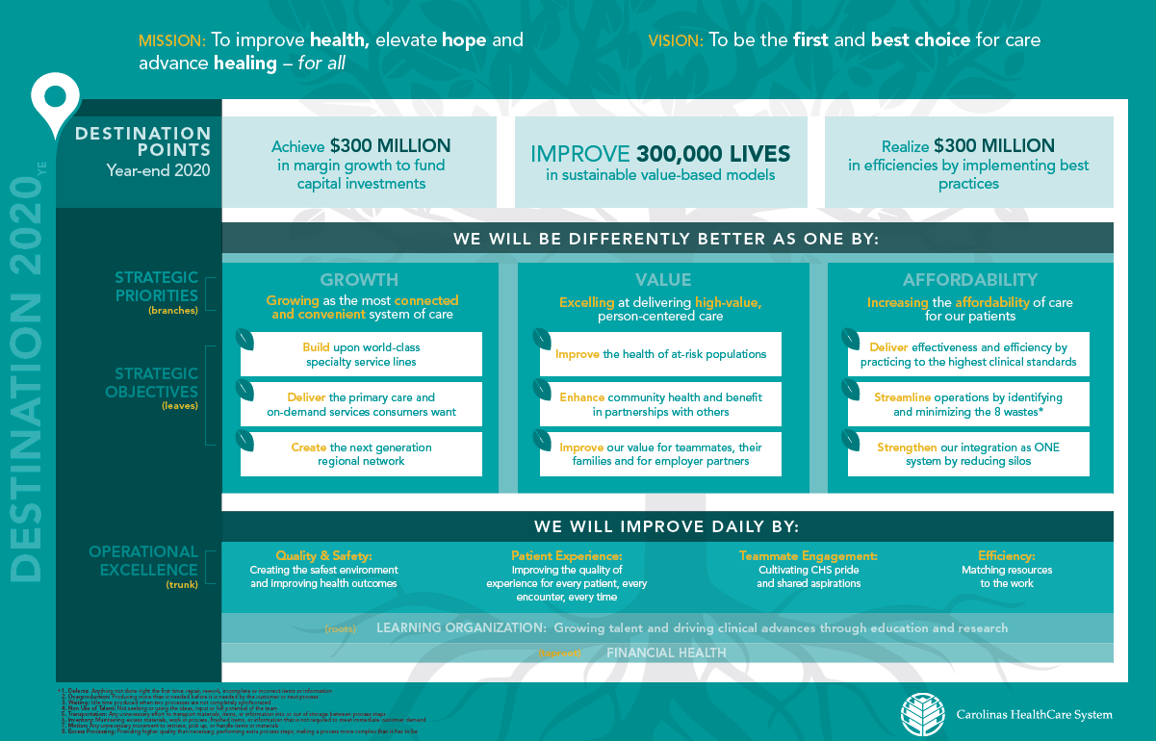

Slide 21
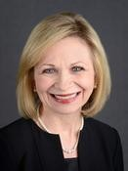
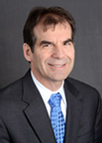

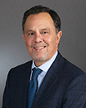
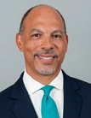
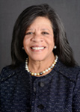
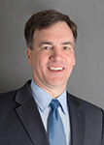
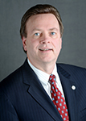
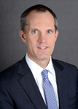
Carolinas HealthCare System
Executive Leadership
Carol Lovin
EVP
Chief Strategy Officer
Greg Gombar
EVP & CFO
Roger Ray
EVP
Chief Physician Executive
Armando L. Chardiet
President
Carolinas HealthCare Foundation
Gene Woods
President & CEO
Debra Plousha Moore
System Chief of Staff
Ken Haynes
EVP & COO
Jerry Oliphant
EVP
Regional Operations
Keith Smith
EVP
General Counsel
21

Slide 22
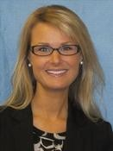
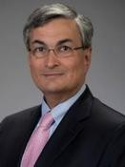
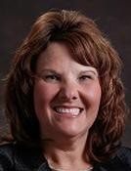
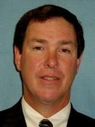
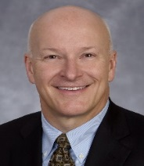
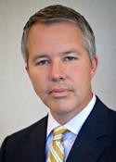
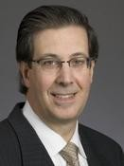
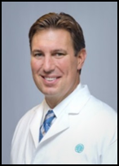
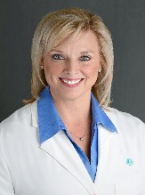
CHS Medical Group Division
Katie Kriener
VP / Division Chief
of Staff
Ruth Krystopolski
SVP / Population Health
James Hunter, MD
SVP / Chief Medical Officer
Stacy Nicholson, MD
President / Childrens Svcs, Pediatrics
Derek Raghavan, MD
President / LCI
Roger Ray, MD
EVP &
Chief Physician Executive
Tom Laymon
SVP / Chief Care Delivery Operations
Paul Colavita, MD
President / SHVI
Scott Rissmiller, MD
Deputy Chief Physician Executive
Jennifer Brady, MD
CEO / Carolinas Physician Alliance
22

Slide 23
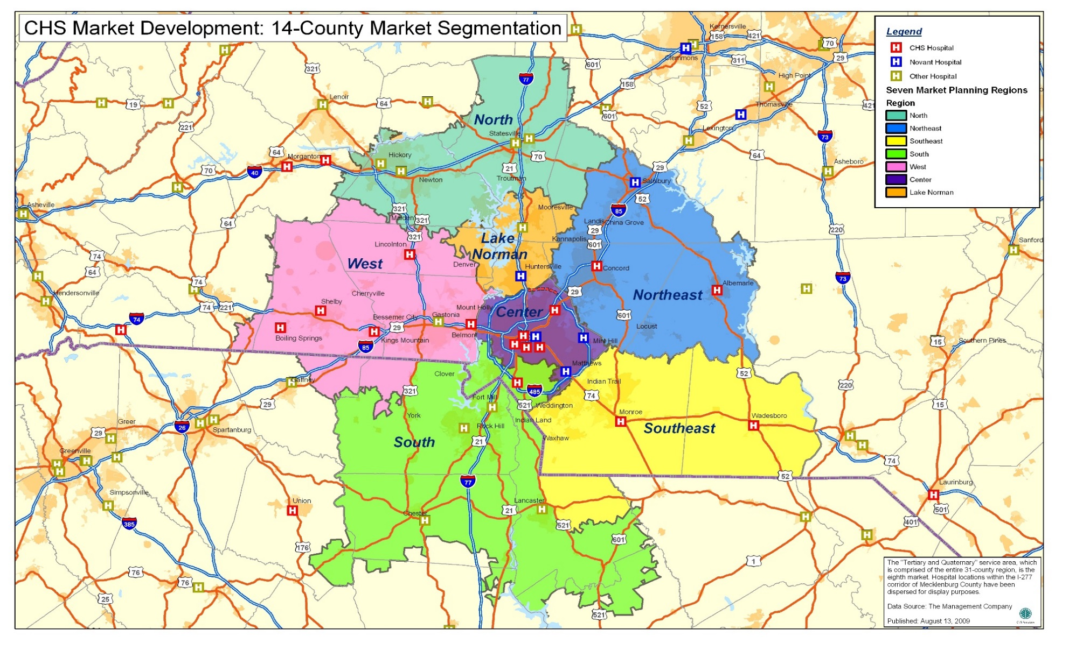
Integration of the CHS Medical Group throughout our
Primary Service Area
23

Slide 24
CHS System Provider Regional Relationships
CHS Regional Medical Group
CHS Hospital Providers
St. Lukes
Scotland
Columbus
New Hanover
Management Services Agreement for Physician Network . Employed by CHS.
Blue Ridge
Roper/St. Francis
AnMed Health
Cone Health
Murphy
Providers are employed locally not directly by CHS.
24

Slide 25
CHS “System” Medical Group
Metro Market Structure
Division Operations
Finance
Primary Care
Quality and Patient Experience
Surgery
Research / Education
Leadership
Adult Acute
Teammate Engagement
CHS Medical Group Executive Council
Children’s Services
Information & Analytics Services
Sanger Heart & Vascular Institute
ACP Oversight
Compensation
Levine Cancer Institute
Diversity /Inclusion
Behavioral Health
Phys/ACP Engagement & Wellness
All care divisions and service lines include academic services and functions

Slide 26
CHS Medical Group Division Matrix and Integrated Support Structure
Primary Care
1,800 Physicians
270 Residents
2,070 Total Physicians
Plus over 600 Advanced Clinical Practitioners (ACP)
LCI/BH/SHVI
Surgical Services
Marketing
RX
CHSMG Care Delivery Operations
IS
Lab
Quality
CBO
Pediatric Specialties
Adult Acute Care
HR
MHR/
Contracts
Finance
Real
Estate
Services
Scope:
Multiple Care Delivery Divisions
Millions of Office Visits
Hundreds of Locations
ONE VISION
26

Slide 27
CHS Medical Group Division

Slide 28
CHS Medical Group Division - Guiding Principles
Ensures community healthcare needs are met by providers and aligned with CHS resources (through a vertical integration model)
Captures and expands market share through multiple service strategies that eliminate access barriers, meet patient needs across a broad spectrum of convenient outpatient healthcare services, and provide new portals through which patients can enter the System
Strengthens financial viability through purposeful growth and unified infrastructure systems & metrics
Contributes to achievement of quality goals and efficient use of facility resources through the provision of clinically effective, timely, satisfying and coordinated patient care
28

Slide 29
CHS Medical Group Division - Guiding Principles (continued)
Enhances customer service and patient relationship with the System by maximizing ease of patient access and ensuring a satisfying and worthwhile appointment experience
Maintains exceptional relationships with patients by guaranteeing ease of access to highly motivated, competent and engaged physicians and employees
Leverages Medical Education & Research programs to enhance clinical services and differentiate the System regionally and nationally
29

Slide 30
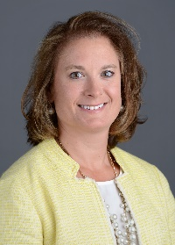
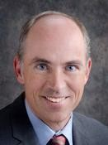
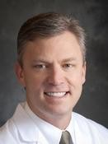
Adult Acute Care Leadership
Dr. Scott Furney
Senior Academic
Medical Director
Shannon Carpenter
Vice President
Dr. Scott Lindblom
Senior Medical Director
Specialty | Clinical Leader | Academic Leader
Hospitalists | Dr. Ryan Brown | Dr. Lane Jacobs
Critical Care | Dr. Michael Green | Dr. Steve Cochran
Pulmonary | Dr. Daniel Howard | Dr. Robert Taylor
Emergency Medicine | Dr. Mike Gibbs
GI | Dr. Tom Pacicco | Dr. Martin Scobey
Infectious Disease | Dr. Lewis McCurdy | Dr. James Horton
Hepatology | Dr. Mark Russo
PM&R | Dr. Bill Bockenek
Palliative Care | Dr. Bea Skudlarska
Geriatrics | Dr. Bea Skudlarska
Adult Neurology | Dr. Robert Mitchell
30

Slide 31
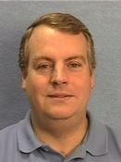
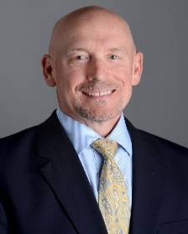
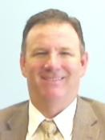
Primary Care & Medical Specialties Leadership
Dr. Al Hudson
Senior Medical Director
Dr. John Franko
Primary Care Division Academic Leader
Jeff Ozmon
Senior Vice President
Specialty | Clinical Leader | Academic Leader
Family Medicine | Dr. Dan Senft | Dr. Mark Robinson
Internal Medicine | Dr. Carmen Teague | Dr. Tom Montgomery
OB/GYN | Dr. John Phillips | Dr. Susan Bliss
Urgent Care | Dr. Alfred Kendrick | Dr. Alfred Kendrick
Corporate Health | Dr. Charlie Rich | Dr. Larry Raymond
Sports Medicine | Dr. Kevin Burroughs | Dr. David Price
Medical Specialties | Dr. Robert Mitchell | Dr. Kelli Dunn
Dermatology | Dr. Dan Parsons
Rheumatology | Dr. Firas Kassab
Sleep Medicine | Dr. Doug Kirsch
Endocrinology | Dr. Gary Rolband
Allergy | Dr. Ekta Shah
31

Slide 32
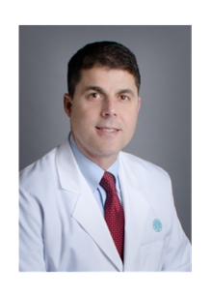
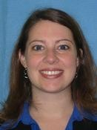
Surgery Leadership
Dr. Brent Matthews
Senior Medical Director/Academic Medical Director
Lauren Rorabaugh
Vice President
Specialty | Clinical Leader
Bariatrics | Dr. Keith Gersin
Surgery | Dr. Mike Thomason
Plastics | Dr. Adam Ravin
Urology | Dr. Chris Teigland
Orthopaedics | Dr. Ed Hanley
Oral Medicine & Surgery | Dr. Mike Brennan
Specialty OB/GYN | Dr. Robert Higgins
Ophthalmology | Dr. Galen Grayson
Pediatric Surgery | Dr. Tony Stallion
32

Slide 33

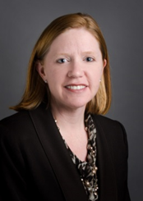
Children’s Services Leadership
Dr. Stacy Nicholson
President
Jennifer Terry
Vice President
Specialty | Clinical Leader
Critical Care | Dr. David Fisher
Neonatology (PICU)
Hospitalists | Dr. Mary Rogers
Child Maltreatment/ Adolescent Medicine/ Newborn
Pediatric Specialty 1 | Dr. Susan Massengill
Renal/ Rheumatology/ Endocrinology
Pediatric Specialty 2 | Dr. Joseph Stegman
Genetics/ Infectious Disease/ Pulmonary/ Developmental
Gastroenterology | Dr. Victor Pineiro
Oncology/BMT/Palliative Care | Dr. Javier Oesterheld
Pediatric Neurosciences | Dr. David Griesemer
Surgery | Vacant
33

Slide 34
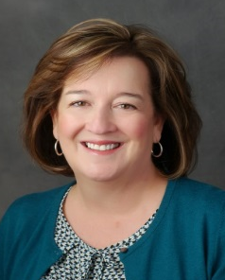
Behavioral Health Leadership
Vacant
Chief Clinical Officer
Martha Whitecotton
Senior Vice President
Specialty/Division | Clinical Leader | Administrative Leader
Behavioral Health Service Line |  | Martha Whitecotton, SVP
Behavioral Health Facility Executive - Charlotte | Dr. James Rachal | Victor Armstrong, VP
Behavioral Health Facility Executive - Davidson | Dr. Cheryl Dodds | Tom Gettelman, VP
Behavioral Health Northeast | Dr. John McKinsey | Sue Deluca, VP
Behavioral Health CNE | Dr. Jennifer Ziccardi
Behavioral Health Emergency Services | Dr. Wayne Sparks | Sue Deluca, VP
Behavioral Health Addiction Medicine | Dr. Steve Wyatt | Sue Deluca, VP
Behavioral Health Consult Liaison | Dr. Jay Yeomans | Victor Armstrong, VP
Behavioral Health Primary Care Integration | Dr. Manuel Castro | Sue Deluca, VP
34

Slide 35
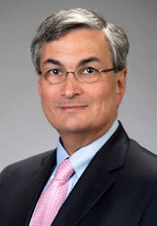
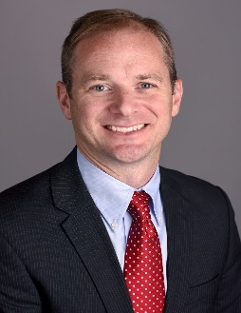
Levine Cancer Institute Leadership
Dr. Derek Raghavan
President
Kevin Plate’
Vice President
Specialty | Clinical Leader
Radiation Oncology | Dr. Stuart Burri
Solid Tumor Oncology & Investigational Therapeutics | Dr. Ed Kim
Hematologic Oncology & Blood Disorders | Dr. Ed Copelan, Chair Dr. Belinda Avalos, Vice Chair
Medical Operations | Dr. Jean Chai, Medical Director Dr. Jonathan Gerber, Co-Director
Surgical Operations | Dr. Jeff Kneisl, Medical Director
Surgical Oncology | Dr. Richard White
Supportive Oncology | Dr. Declan Walsh
35

Slide 36

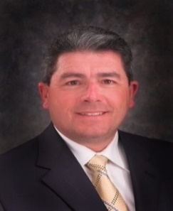
Sanger Heart & Vascular Institute Leadership
Dr. Paul Colavita
President
Scott Moroney
Vice President
Specialty/Division | Clinical Leader
Central Region | Dr. Jim Bower
North Region | Dr. Craig Clinard
Southeast Region | Dr. Kushal Hand
South Region | Dr. Justin Haynie
West Director | Dr. Nelson Seen
Northeast Director | Dr. Ashesh Patel
Invasive Labs | Dr. Bill Downey
Imaging | Dr. Tom Johnson
Vascular Surgery | Dr. Frank Arko
Specialty/Division | Clinical Leader
CV Surgery | Dr. Joseph McGinn
Cardiology | Dr. Geoffrey Rose
Congenital Heart Center | Dr. Paul Kirshbom
Heart Failure | Dr. Sanjeev Gulati
Electrophysiology | Dr. Rohit Mehta
Research | Dr. Mike Rinaldi
CV Surgery | Dr. Joseph McGinn
Cardiology | Dr. Geoffrey Rose
Adult Surgery | Dr. Eric Skipper
Pediatric Cardiology | Dr. Rene Herlong
36

Slide 37
Dr. Roger Ray & Dr. Alisahah Cole
Team of Teams: From US Military to CHS
37

Slide 39
New Physician & ACP Expectations
39

Slide 40
New Physician & ACP Surveys
Source
Physician & ACP Engagement & Wellness Committee & Medical Group Development Retention Team
Purpose
To obtain feedback from new Physicians & ACPs, and their co-leadership team, and utilize that feedback to make improvements to the new provider recruitment and onboarding process at CHS
Frequency
Once the new Physician/ACP starts at Carolinas HealthCare System, they are surveyed at 1 month, 6 months, and 1 year. Each new Physician/ACPs co-leadership team is surveyed again, 30 days after the new Physicians/ACPs start date
40

Slide 41
New Physician Focus Group
Attendees
Consist of new physicians who joined CHS within the last year
A cross section of Care Divisions and Service Lines throughout Carolinas HealthCare System are represented
Purpose
To obtain feedback from new physicians and utilize that feedback to make improvements to the new physician experience at CHS
Discussion among the group focused on three different areas: recruitment, onboarding and retention.
Facilitators
Physician leaders from the Physician & ACP Engagement & Wellness Committee (among different Care Divisions and Service Lines) facilitate the discussion
41

Slide 42
Our Commitment
Timely Access
  We strive to provide:
    Timely access to our care teams and appropriate healthcare options
    (Ex. CarolinaConnect, hospitals, emergent and urgent care, physician office
    and virtual care)
    Patients easy and transparent access to their medical records
Top Quality Cost Effective Care
  We strive to provide:
    Evidenced based care in conjunction with shared decision making
    Appropriate tests and treatments to ensure a value driven patient care experience
    An integrated system of care to improve clinical outcomes and
    patient experience.
    A system of care that is easy to navigate and always puts the patient first
    Patients with culturally competent care
Open Communication
  We strive to provide:
    Our patients with an environment of care that fosters enduring empathetic relationships with their providers
    Our patients with transparent and honest dialogue
    Our patients with timely responses
    Information that is clear and understandable, including patient medical bills
Unified Care Coordination (Integrated System of Care)
  We strive to provide:
    A comprehensive scope of services
    Communication across care teams to ensure a seamless transition of care
    An integrated system of care that fosters greater coordination of services and resources
Core Behavior Expectations
  We strive to provide:
    Professional and personal growth through continual learning experiences
    and leadership opportunities
    A culture that promotes CHS Core Values (Caring, Commitment, Integrity, Teamwork) and One Experience Behaviors by incorporating the CURO Conversations (Connect/Understand/Reveal & Relate/Outcomes).

Slide 43
Physician Recognition Gala
October 21, 2017

Slide 44
ACP Appreciation Banquet

Slide 45
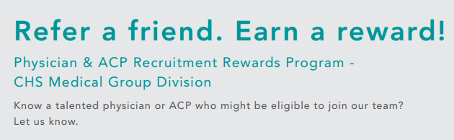
Candidate Eligibility
All candidates must be BE/BC in their specific specialty (if applicable), with a license in good standing for all states where license is held
Only candidates who are currently not employed by CHSMGD can be referred. Current CHSMGD teammates transferring into a new position are not eligible
CHSMGD Physicians & ACPs who left the System within 1 year or less are not eligible
Teammate Eligibility
Referring teammate must employed with CHS at the time the referral bonus is paid
The following are not eligible:
Site Based Medical and above are ineligible to receive a bonus for positions in which they are already involved in the recruiting process
Referral bonus amounts:
$5000 for referral of a full-time CHSMGD physician
$2,500 for referral of a part-time CHSMGD physician
$2,500 for referral of a full-time CHSMGD ACP
$2,500 for referral of a part-time CHSMGD ACP
How to apply
Email candidate name, contact information, and current CV to providerrecruitmentrewards@carolinashealthcare.org

Slide 46
Hot Topics

Slide 47
Clinical Redistribution of Tasks
30 min
29 min
28 min
27 min
26 min
25 min
24 min
23 min
22 min
21min
20 min
19 min
18 min
17 min
16 min
15 min
14 min
13 min
12 min
11 min
10 min
9 min
8 min
7 min
6 min
5 min
4 min
3 min
2 min
1 min
Complete Patient Education Material
Order Meds
Order Procedures
Order Rads
Order Consults
Order Labs
Follow-Up Appointment
Enter Diagnosis
Satisfy Health Maintenance Alerts
Review and Reconcile Meds
Document Visit
Complete Forms
Complete Patient Education Material
Summary / Shared Decision Making / ?’s
Order Meds
Order Procedures
Order Rads
Order Consults
Order Labs
Follow-Up Appointment
E&M
Enter Diagnosis
Problem List Update
Satisfy Health Maintenance Alerts
Medical Decision making / Diagnosis
Review and Reconcile Meds
Patient Exam
Greet and Interview Patient
Notes and Documents review
Login
Document Visit
Complete Forms
Complete Patient Education Material
Summary / Shared Decision Making / ?’s
Order Meds
Order Procedures
Order Rads
Order Consults
Order Labs
Follow-Up Appointment
E&M
Enter Diagnosis
Problem List Update
Satisfy Health Maintenance Alerts
Medical Decision making / Diagnosis
Review and Reconcile Meds
Patient Exam
Greet and Interview Patient
Notes and Documents review
Login
Decreased Provider Tasks
TIMELINE
Document Visit
Complete Forms
Summary / Shared Decision Making
E&M
Problem List Update
Medical Decision making / Diagnosis
Patient Exam
Greet and Interview Patient
Notes and Documents review
Login
Execute Orders
Prep for Exam
Protocol / Injections
Print PCS and Health Maintenance Form
Review Health Maintenance
Verify Patient Pharmacy Info
Enter Pulse Oximeter and Route Method
Review Social History
Review AMB Allergy & Med
Enter Vitals in EMR
Enter Visit Info in EMR
Check Vitals
Obtain Form / Call Patient
Provider Tasks
CMA Tasks
Notes:
1. Who Leads: AMD/VP 2. Who Leads: SBMD/AVP
Audience: SBMD/AVP Audience: All Providers in Practice and Practice Manager and other Practice Leaders (Clinical Supervisor, Office Coordinator, etc.)
Demonstrates tasks that were formerly performed by Provider that can be shifted to a Clinical Assistant with proper training.

Slide 48
SKILL OPTIMIZATION
Medication Safety & Pharmacology exam review Market Forces Changing Healthcare 6 Stages of the Change Model LEAN Basics: Principles & Tools Care Model Redesign CHSMG Quality & Safety Scope of Practice Medication Safety & Pharmacology Exam Medication Safety & Pharmacology Exam Remediation Medication Safety & Pharmacology Exam Retest Hands on Skills Lab - Initial Clinical Competencies Point of Care Testing EMR/CPOE Clinical Scenarios Introduction to Coding: Coding Overview ICD-10, CPT & HCPCS

Slide 49
Clinical Care Team Redefined and Skill Optimized
Before Care Model
After Care Model
RN / LPN
Clinical Assistant
CMA Roomer
CMA Flow Manager
Office Visit Care
Ambulatory intake
Vaccine /Med Administration
Prescription refill pool
Health maintenance review
Daily huddle with Provider
Pre-visit huddle with Provider
Agenda Setting
Point of care testing
Order entry & visit coding
Pt education & depart process
Gatekeeper to Provider
Message management
Prior authorizations
Prescription refills
Lab tracking & result management
Pre-visit planning
Ambulatory intake
Message management
Prescription refills
Vaccine/Med administration
Prior authorizations
Result management
RNs - Nurse Supervisor / Triage
Preceptor/Nurse Supervisor
Standard Triage Protocols allow RNs to work to the top of license
Allows improved first call resolution for patient and reduction in provider messages
Notes:
1. Who Leads: AMD/VP 2. Who Leads: SBMD/AVP
Audience: SBMD/AVP Audience: All Providers in Practice and Practice Manager and other Practice Leaders (Clinical Supervisor, Office Coordinator, etc.)
Demonstrates the realignment of work between “Roomers” , “Flow Manager” and RNs in the practice or RNs utilized as Triage Nurses at the Regional Operations Centers (ROC)

Slide 50
2017 Quality & Patient Experience Goals

Slide 51
CHS Quality & Patient Experience Goals Process 2017
CHS Quality & Patient Experience Goal Planning
May/June
Contribution Sources
June / July
Medical Groups
Acute Care
Continuing Care
Service Lines
CHS Clinical Leadership Groups
CHS QSOCs
CHS Quality & Patient Experience Goals Retreat
July 20, 2016
Development of Additional Business-Unit-Specific and/or Service Line Quality & Experience Goals
Preliminary QCC Affirmation of Priorities
Aug 23, 2016
Definition, Baseline & Target Development
by Oct 14, 2016
Business Units Affirm Goals
by Nov 4, 2016
QCC: Endorses 2017 Goal Targets
Nov 15, 2016
QCC Chair Reviews Specific Goals Final Goals Published to BOC for Comment
Dec 13, 2016
2017 CHS Quality & Experience Goal Kick-Off
Jan 1, 2017

Slide 52
General Guidelines for Setting Target and Stretch
Find a comparative national benchmark, if possible.
Focus on the top quartile as either the target or stretch goal for the System depending on the baseline performance for that metric and the anticipated improvement that is possible in the coming year.
If a facility/network is currently performing above the System stretch goal then their goals will be developed to encourage maintaining these gains.
For all other facilities/networks, target and stretch goals are assigned by an algorithm at an increasing percentage in order to allow for the System to meet the overall target and stretch goals if all facilities meet their individual goals.
*For 2017, Antibiotic Stewardship, Hospital Overall Rating and Hospital Communication will be setting facility target and stretch goals first. These individual facility goals will then make up the CHS level goals.

Slide 53

Premier Methodology
A large number of Carolinas HealthCare System facilities participate in the Premier Alliance Quality Advisor
Premier provides national and regional benchmarking
Benchmarks for mortality, length of stay, and readmissions were chosen based on Premier’s
National Benchmarks
Demographics
Number of Facilities Included (Percentage of All US Hospitals) | Approximately 1,153 hospitals (33%)
Urban Location | 842 hospitals (73%)
Average Bed Count | 210 beds
Average Number of Discharges (CY 2014) | 11,025 patients
Total Number of Discharges (CY 2014) | 8,202,344 patients (4% are CHS)
82
30
134
74
158
108
133
296
123

Slide 54

HEDIS Methodology
The Healthcare Effectiveness Data and Information Set (HEDIS) is a tool used by more than 90 percent of America's health plans to measure performance on important dimensions of care and service.
With oversight from NCQA (National Committee for Quality Assurance) HEDIS consists of 81 measures across 5 domains of care publishing yearly benchmarks for Medicare, Medicaid and Commercial populations.
Originally designed to address private employers’ needs as purchasers of health care, HEDIS measurement specifications have been adapted for use by public purchasers, regulators, consumers and clinicians
HEDIS® 2016
Technical Specifications
for Physician Measurement
http://www.ncqa.org/HEDISQualityMeasurement/WhatisHEDIS
HEDIS is a registered trademark of the National Committee for Quality Assurance (NCQA).

Slide 55
Carolinas HealthCare System Goals 2017
Priority #1: Patient Safety | Acute Care Patient Safety Composite
 | Medication Safety in the Elderly
 | Acute Care Antibiotic Stewardship
Priority #2: Clinical Outcomes | Acute Care Mortality
 | Diabetes Outcome Composite
 | Prevention Composite
Priority #3: Patient Experience | Overall Rating Composite
 | Communication Composite
Priority #4: Clinical Efficiency | Acute Care Length of Stay
 | Acute Care Unplanned Readmissions

Slide 56

2017 QCC Goals: New/Expanded
Priority #1: Patient Safety | Acute Care Patient Safety Composite | Remove PC-02 and Patient Falls. Make the composite 15% AHRQ PSI 90 and 85% NHSN Infections. Pull infections from NHSN using exact CMS Hospital Compare criteria.
Priority #2: Clinical Outcomes | Acute Care Mortality | Remove the hospice exclusion to match CMS criteria.
 | Prevention Composite | Add Depression Monitoring.
Priority #3: Patient Experience | Overall Rating Composite | Removed Likelihood to Recommend Composite and added Overall Rating Composite.
Priority #4: Clinical Efficiency | Acute Care Unplanned Readmissions | Remove the hospice exclusion to match CMS criteria.

Slide 57
Additional Information
The 2017 QCC Scorecard will be reported monthly in Tableau which will launch in February 2017 for the first scorecard. Training is available via video at this link:
2017 QCC Scorecard
Please access the 2017 QCC Definitions Document at the following link on the Quality Portal:
2017 QCC Definitions

Slide 58
Patient Satisfaction Transparency
Transparency Appeal Committee Onboarding

Slide 59
Control & Accuracy
CHS Providers will have more control of online reputation – We have better control over patient satisfaction data that will be housed on our CHS website compared to questionable ratings produced by Healthgrades, Yelp and others
Helps patient make right connection with right provider – Our patients deserve accurate information about our physicians
When searching for a physician on a search engine (i.e. Google), the CHS find a doc portal will display as the first option due to the quantity of reviews
Accuracy Counts: 80% of patients will change their mind upon reviewing a negative review (Digital Trends – 2012)
Empowers patients to make informed decisions regarding their healthcare
59
Notes:
This slide can be used as talking points or to share publicly

Slide 60
Star Ratings and Patient Comments
Star Ratings
  Rolling 12 months of data
  Refreshed in real time
Patient comments:
  Rolling 12 months of data
  Refreshed every 4 weeks
  Scrubbed for profanity, privacy violations, names of other providers and for references to providers physical appearance
  Providers see comments 2 weeks before they go on-line

Slide 61
Notes:
Speaker notes: This is the ONLY portion of the Press Ganey survey that will be reflected in your star rating. This is about YOUR interaction with the patient – nothing else that happens at the practice or other facility (ie., front desk person’s behavior or parking deck experience) Most organizations are also including patient’s perception of their ait time as a separate rating. CHS has not decided yet, among others.

Slide 62
Star Ratings
Tell an Excellent Story
Question | Average Stars | # of Ratings
Friendliness/Courtesy of Provider | 4.84 | 221,926
Provider Explained Things Clearly | 4.79 | 220,866
Provider Showed Concern | 4.78 | 220,871
Provider Included You in Decisions | 4.78 | 218,087
Provider Gave Information about Medications | 4.77 | 203,495
Provider Gave Instructions about Follow-Up Care | 4.77 | 209,576
Provider Gave Understandable Instructions | 4.84 | 220,813
Provider Spent Enough Time | 4.75 | 221,457
Your Confidence in this Provider | 4.78 | 221,166
Likelihood of Recommending this Provider | 4.76 | 220,071
Carolinas Average Physicians/ ACPs Rating | 4.78 | 222,669
(Based on NRC “Live” Physicians/ ACPs Data on 6/28/16)
*As of 6/28/2016

Slide 63
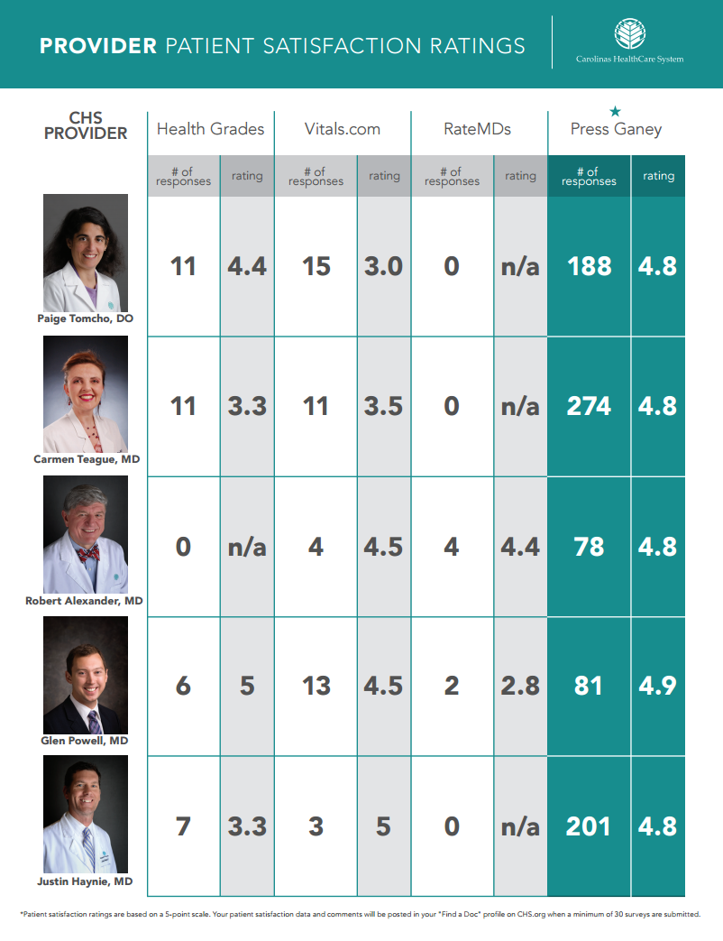

Slide 64
Overall Comment Review Process
Comments will be uploaded monthly to the Transparency portal (NRC).
Comments will go through two reviews. The first review will be completed by NRC and the second will be completed by the Patient Experience team.
Comments will be sent on the 15th of each month from the Patient Experience Mailbox to Physicians / ACPs.
Physicians / ACPs will have two weeks to review comments before they are posted.
Physicians / ACPs will not be mandated to review comments. Comments that are not reviewed will be posted based on pre- defined criteria.
A Transparency Appeals Committee (Comprised of the Care Division leaders or designees) will review any comments that are appealed by Physicians / ACPs.
Appeals can be made by emailing the Patient Experience Department.

Slide 65
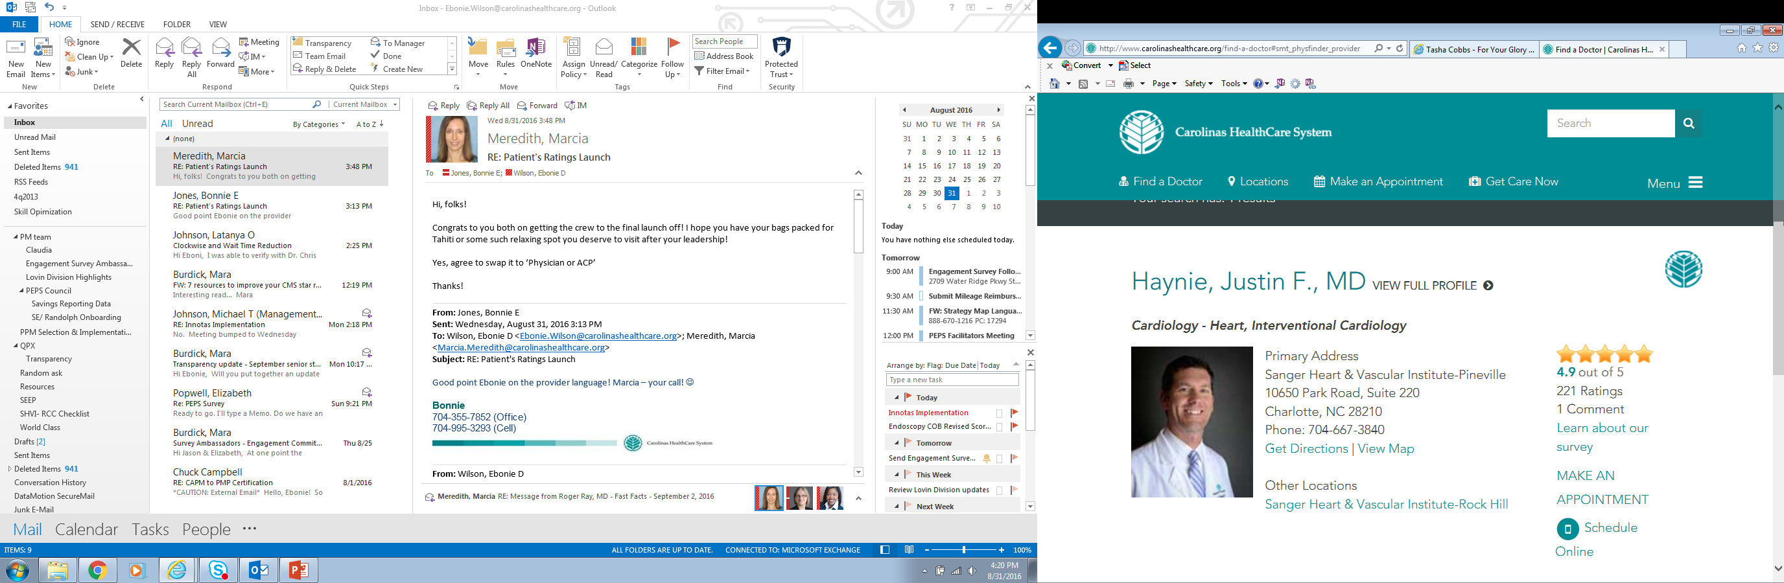
Abbreviated Profile

Slide 66
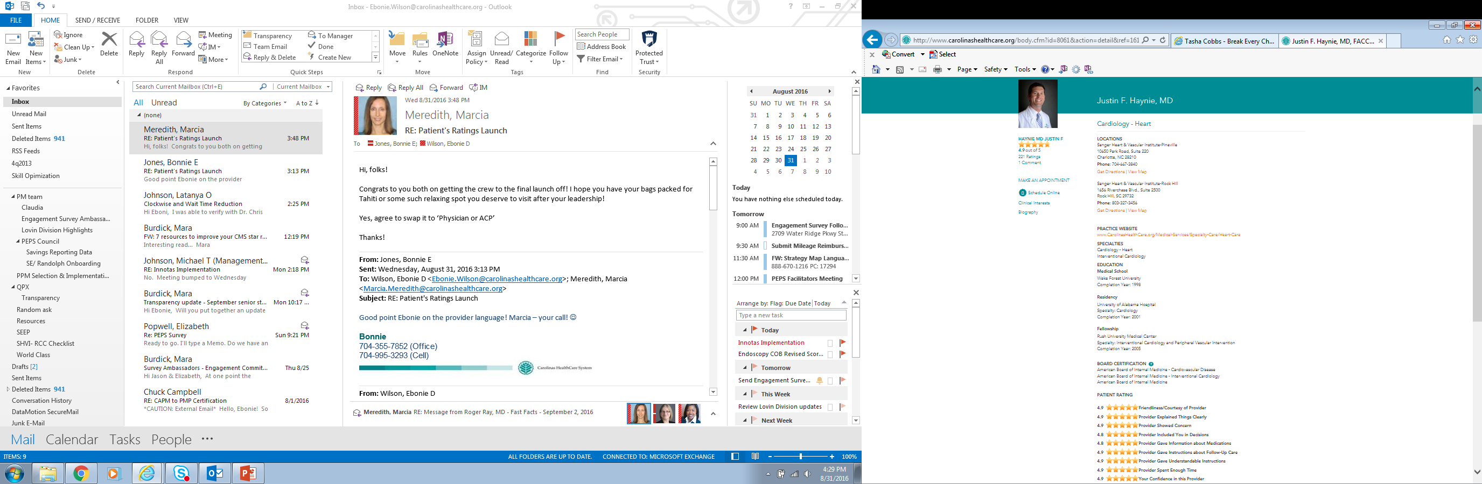
Full Profile

Slide 67
MyCarolinas

Slide 68

How to Take Charge of Your Medical Records
WSJ 06/29/15
Patients have a lot to gain by getting access to their health information. They just need to know where to get it—and what to do with it.-WSJ, 06/29/15

Slide 69
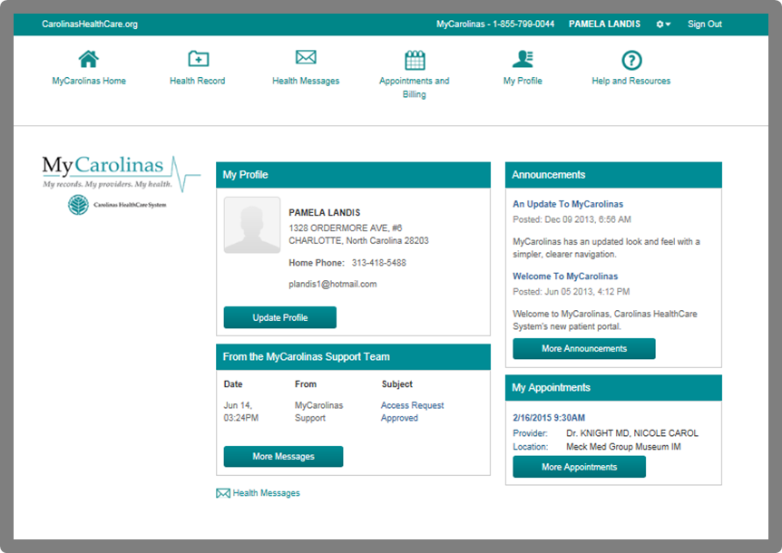
MyCarolinas
Current Functionality:
Labs
Tests
Allergy List
Med List
Problem List
Surgical List
Secure Messaging
Rx Renewal
Appt. Scheduling
Discharge and Depart Summaries
GetWell Video
OpenNotes
Notes:
MyCarolinas helps reduce task fatigue. It creates an easy way for patients to take control of managing their health in partnership with providers.

Slide 70
OpenNotes – Key Messages
Creates a healthier,
more engaged patient
Inspires patients to participate in their care
Improves patient recall of care plan
Improves medication adherence
Empowers patient through shared decision-making
Patients who read their notes regularly are more likely to have a better understanding
of their health
In a 2012 OpenNotes Study:
  Patients Reported:
  83% of patients felt more in control of their health
  82% understood conditions better
  71% took better care of themselves
  70% took medication more regularly
  Providers Reported
  97% did not spend more time on visits
  80% said sharing notes is useful
  70% did not spend any more time on notes
  70 % reported improved relationships
Improves communication
& fosters open dialogue
Only prospective notes as of September 2015 shared
Physicians can make certain notes sensitive
Providers have right to block certain patients or individual notes
Providers have control

Slide 71
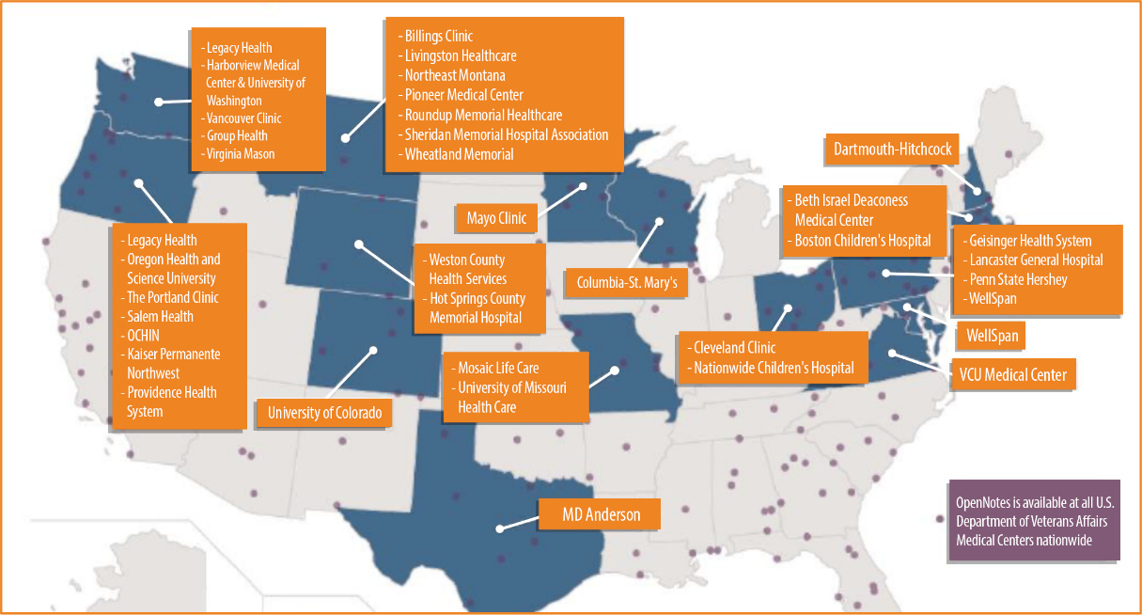
Nationwide Snapshot

Slide 72
What’s Viewable. What’s Not.
OpenNotes
Notes that will not be shown
History and Physicals
Operative and Procedure Reports
Office Visit Notes
Documents scanned into the selected OpenNote Types will be visible in MyCarolinas
Child advocacy
Forensic documentation
Behavioral health
Progress notes
Chemical dependency notes
Consult notes
Nursing and interdisciplinary team documentation
Administrative documentation
Sensitive note type

Slide 73
When it’s Viewable
Lab and Test Results
Radiology reports
Open Notes
24 hours after finalization
5 days after finalization
Upon Signature

Slide 74
Tips for Sharing Notes
Avoid jargon and abbreviations, especially ones that might be easily misinterpreted (“SOB” or “BID”)
  “patient complains of” = “patient reports”
  “patient denies alcohol use” = “patient reports no alcohol use”
  “patient refuses influenza vaccination” = “patient declines influenza vaccination”
Keep it Simple
Obesity, for example, is a medical term with a definition. Perhaps seeing it in writing will reduce patient denial and improve motivation
Complement sensitive behavioral health diagnoses with non-judgmental descriptive terms, where possible, to
avoid labeling
Highlight the patient’s strength and achievements alongside their symptoms and clinical problems to endorse patients’ attributes and empower positive change.
Be mindful of sensitive topics and remember patients have rights under HIPAA to access their record
Balance Perspective

Slide 75


Other Strategic & Operational Initiatives
Care Management
Virtual Care
Employer-focused Clinics
Canopy Efficiency
Stability / Powerchart Touch / Specialty Views / Training / Care Pathways
Behavioral Health Integration
Integrated Practice Units (Cardio)
Transition Clinic
Leadership Development
Change Management (Comm Strategy & Toolkits)
Notes:
These are the right things to do to improve PATIENT CARE
And…
These are the right things to IMPROVE physician job DOABILITY

